Slide 1
01 / 06
National University of Singapore
IRIS Research Presentation
Physics-Informed Hidden Regime Discovery
and Local Symbolic Law Learning
for Semi-batch Polymerization Reactors
S ASIFA
College of Design & Engineering
Chemical & Biomolecular Engineering
Project Advisor: Assoc Prof. Lakshminarayanan Samavedham

Slide 2
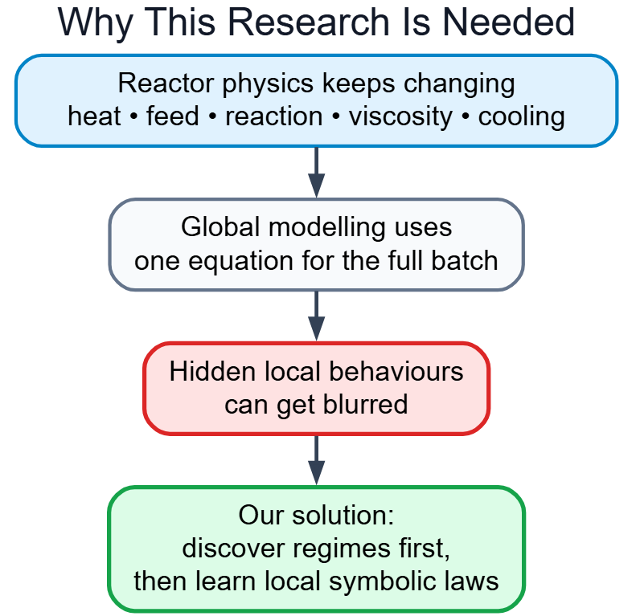
INTRODUCTION & MOTIVATION
02 / 06
Problem Statement
A nonlinear chemical reactor should not be modelled using a single global equation, because its behaviour changes across different operating regions. In semi batch polymerization, the reactor passes through heat-up, monomer feeding, active reaction, cooling, viscosity growth, and hold stages. Each stage follows different local dynamics, and these hidden changes can be blurred when the entire reactor is forced into one global model. Therefore, this work first discovers hidden reactor regimes and then learns separate symbolic laws within each regime.
Therefore, the reactor could have hidden local behaviors, not one simple behavior.
Motivation
The motivation is to build a physics-informed AI framework that discovers hidden operating regimes in the Chylla-Haase semibatch polymerization reactor. Instead of forcing the whole reactor into one global model, this work identifies local reactor behaviours and learns separate interpretable symbolic laws for each regime.

Slide 3
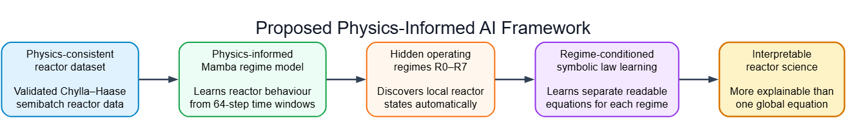
03 / 06
Proposed Physics-Informed AI Framework
. From reactor time-series data to hidden regimes and readable symbolic laws
Generates realistic Chylla–Haase reactor trajectories using energy balance, mass balance, reaction heat, cooling, and valve dynamics.
Uses sliding windows to learn how reactor behavior evolves over time, capturing coupled changes in reaction heat, viscosity, temperature, and cooling.
Clusters learned time-series embeddings using Gaussian Mixture Models, grouping similar reactor behaviors into eight hidden regimes without manual labels.
Applies symbolic regression to derive readable local equations that explain temperature-change dynamics within each discovered regime.
Converts complex reactor data into understandable operating states and physical laws instead of one global black-box model.
The framework discovers when reactor behavior changes, then learns a separate symbolic law for each discovered state instead of stating one global equation.

Slide 4
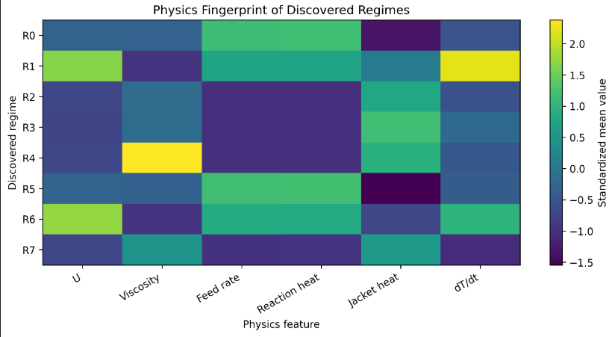
04 / 06
Hidden Regime Discovery using the Proposed Framework
The model discovers reactor states that were not manually labelled.
PI-MambaRegime discovered eight hidden regimes R0–R7 from reactor time-series behaviour.
These regimes were not manually assigned. They emerged by clustering learned reactor embeddings.
These regimes differ in physical features such as viscosity, heat-transfer coefficient U, feed rate, reaction heat, jacket heat, and temperature-change rate.
Each row is a discovered regime; each column is a reactor physics feature.
Regimes R0–R7 have distinct physics fingerprints
The discovered regimes are not random clusters — they represent physically different reactor operating states.

Slide 5
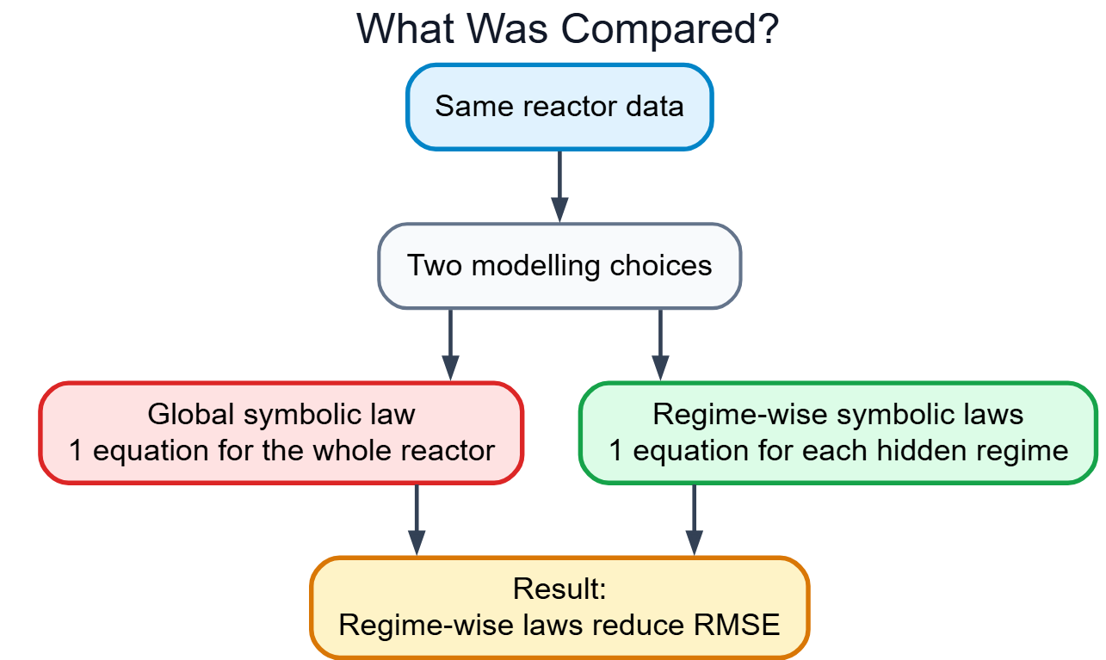
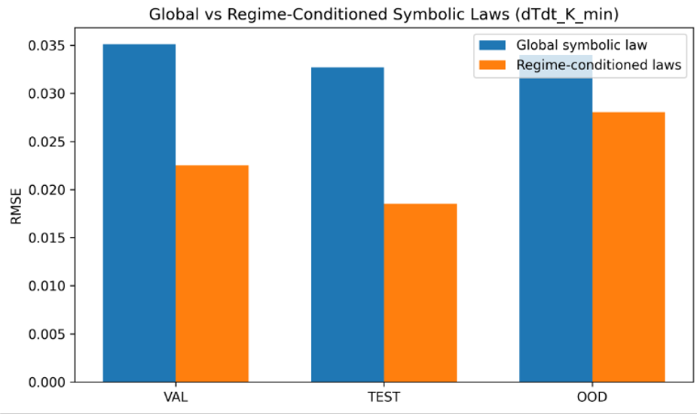
05 / 06
Regime-Wise Symbolic Laws Outperform One Global Law
Separate local equations reduce prediction error across validation, test, and OOD conditions.
RMSE = root mean square error.
What did we compare?
Regime-conditioned symbolic laws reduce RMSE
43.4%
17.6%
lower TEST RMSE
lower OOD RMSE
Main inference: hidden regimes are not only physically meaningful — they improve predictive accuracy.
Lower RMSE = better prediction of reactor temperature-change rate.

Slide 6
CONTRIBUTIONS & CONCLUSION
06 / 06
Contributions & Conclusion
The framework discovers hidden reactor states and converts them into readable local laws.
1. Physics-Consistent Reactor Dataset
1
Built a validated Chylla–Haase semi batch reactor dataset using energy balance, mass balance, reaction heat, cooling, viscosity, and valve dynamics.
2. Hidden Regime Discovery
2
Developed a physics-informed Mamba-based framework that discovers hidden operating regimes from reactor time-series behavior.
3. Local Symbolic Law Learning
3
Used symbolic regression to learn separate readable equations for each discovered regime, improving prediction over one global law.
Conclusion
This work shows that physics-informed AI can discover hidden reactor states and convert them into interpretable local symbolic laws.
THANK YOU

